Slide 1
2
DERIVATIVES

Slide 2
2.2
The Derivative as a Function

Slide 3
The Derivative as a Function
We have considered the derivative of a function f at a fixed number a :
Let the number a vary. If we replace a in Equation 1 by a variable x, we obtain

Slide 4
The Derivative as a Function
Given any number x for which this limit exists, we assign to x the number f ’(x). So, we can regard f ’ as a new function, called the derivative of f and defined by Equation 2. We know that the value of f ’ at x, f ’(x), can be interpreted geometrically as the slope of the tangent line to the graph of f at the point (x, f(x)).
The function f’ is called the derivative of f because it has been ‘derived’ from f by the limiting operation in Equation 2. The domain of f ’ is the set {x | f ’(x) exists} and may be smaller than the domain of f.

Slide 5
Example 1
The graph of a function f is given in Figure 1. Use it to sketch the graph of the derivative f ’.

Slide 6
Example 1 SOLUTION
We can estimate the value of the derivative at any value of x by drawing the tangent at the point (x, f(x)) and estimating its slope.
For instance, for x = 5, we draw the tangent at P in Figure 2(a) and estimate its slope to be about 3/2, so

Slide 7
Example 1 SOLUTION
This allows us to plot the point P’(5, 1.5) on the graph of f ’ directly beneath P.

Slide 8
Example 1 SOLUTION
Repeating this procedure at several points, we get the graph shown in this figure.

Slide 9
Example 1 SOLUTION
Notice that the tangents at A, B, and C are horizontal.
So, the derivative is 0 there and the graph of f ’ crosses the x-axis at the points A’, B’, and C’, directly beneath A, B, and C.
Between A and B, the tangents have positive slope.
So, f ’(x) is positive there.
Between B and C, and the tangents have negative slope.
So, f ’(x) is negative there.

Slide 10
Example 2
(a)If f(x) = x³ – x, find a formula for f ’(x).
(b)Illustrate by comparing the graphs of f and f ’.
SOLUTION:
(a)When using Equation 2 to compute a derivative, we must remember that:
The variable is h.
x is temporarily regarded as a constant during the calculation of the limit.

Slide 11
Example 2(a) SOLUTION
Thus,

Slide 12
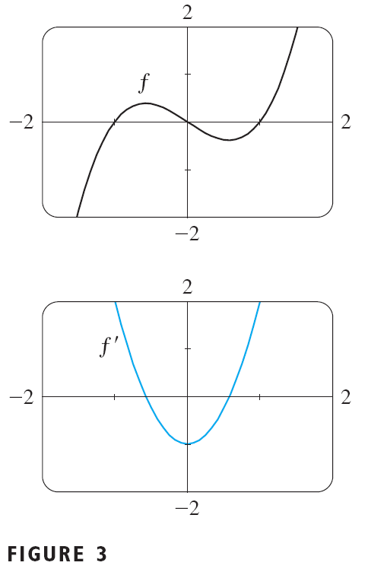
Example 2(b) SOLUTION
We use a graphing device to graph f and f ’ in Figure 3.
Notice that f ’(x) = 0 when f has horizontal tangents and f ’(x) is positive when the tangents have positive slope.
So, these graphs serve as a check on our work in part (a).

Slide 13
Example 3
If , find the derivative of f. State the domain of f ′.
SOLUTION:

Slide 14
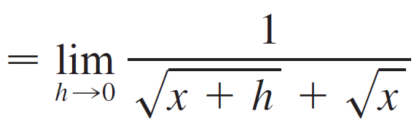

Example 3 – Solution
cont’d
We see f ′(x) that exists if x > 0, so the domain of f ′ is
This is smaller than the domain of f, which is

Slide 15
THE DERIVATIVE AS A FUNCTION
Let’s check to see that the result of Example 3 is reasonable by looking at the graphs of f and f ’ in Figure 4.

Slide 16
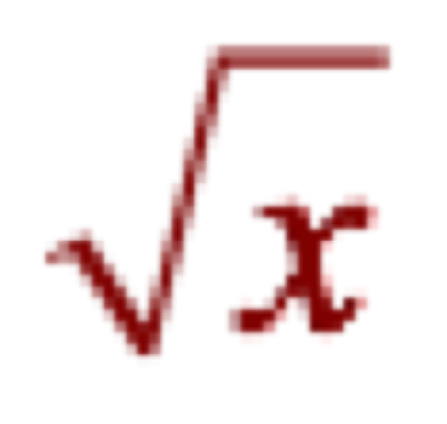
THE DERIVATIVE AS A FUNCTION
When x is close to 0, is also close to 0.
So, f ’(x) = 1/(2 ) is very large.
This corresponds to the steep tangent lines near (0,0) in Figure 4(a) and the large values of f ’(x) just to the right of 0 in Figure 4(b).

Slide 17
THE DERIVATIVE AS A FUNCTION
When x is large, f ’(x) is very small.
This corresponds to the flatter tangent lines at the far right of the graph of f ’.

Slide 18
Example 4
Find f ’ if
SOLUTION:

Slide 19
Other Notations

Slide 20
Other Notations
If we use the traditional notation y = f (x) to indicate that the independent variable is x and the dependent variable is y, then some common alternative notations for the derivative are as follows:
The symbols D and d/dx are called differentiation operators because they indicate the operation of differentiation, which is the process of calculating a derivative.

Slide 21
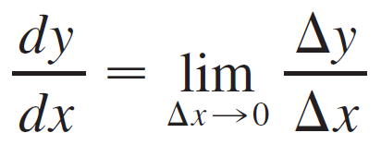
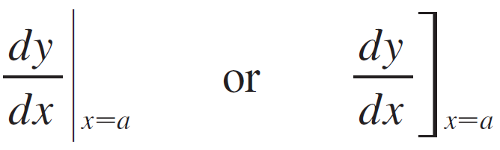
Other Notations
The symbol dy/dx, was introduced by Leibniz and we can rewrite the definition of derivative in Leibniz notation in the form
If we want to indicate the value of a derivative dy/dx in Leibniz notation at a specific number a, we use the notation
which is a synonym for f ′(a).

Slide 22
Differentiable Functions

Slide 23
Differentiable Functions

Slide 24
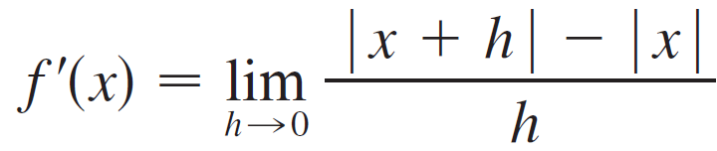
Example 5
Where is the function f (x) = | x | differentiable?
SOLUTION:
If x > 0, then | x | = x and we can choose h small enough that x + h > 0 and hence | x + h | = x + h.
Therefore, for x > 0, we have

Slide 25
Example 5 – Solution
cont’d
and so f is differentiable for any x > 0.

Slide 26
Example 5 – Solution
cont’d
Similarly, for x < 0 we have | x | = –x and h can be chosen small enough that x + h < 0 and so | x + h | = –(x + h).
Therefore, for x < 0,

Slide 27
Example 5 – Solution
cont’d
and so f is differentiable for any x < 0.
For x = 0 we have to investigate

Slide 28
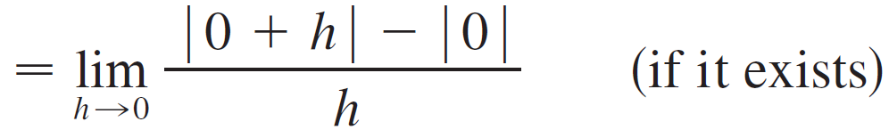
Example 5 – Solution
cont’d
Let’s compute the left and right limits separately:

Slide 29
Example 5 – Solution
cont’d
And
Since these limits are different, f ′(0) does not exist.

Slide 30
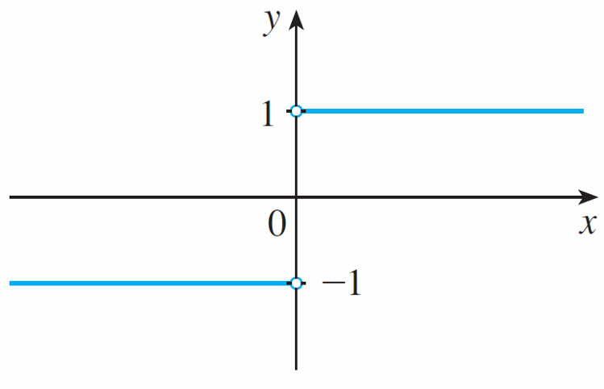
Example 5 – Solution
cont’d
(b) y = f ′(x)
Figure 5
Thus f is differentiable at all x except 0.
A formula for f ′ is given by
and its graph is shown in Figure 5(b).

Slide 31
Example 5 – Solution
cont’d
The fact that f ′(0) does not exist is reflected geometrically in the fact that the curve y = | x | does not have a tangent line at (0, 0). [See Figure 5(a).]
(a) y = f(x) = | x |
Figure 5

Slide 32
Other Notations
Both continuity and differentiability are desirable properties for a function to have.
The following theorem shows how these properties are related.

Slide 33
Theorem 4 PROOF
To prove that f is continuous at a, we have to show that .
We do this by showing that the difference f(x) – f(a) approaches 0 as x approaches 0.
The given information is that f is differentiable at a.
That is, exists.
See Equation 3.1.5.

Slide 34
Theorem 4 PROOF
To connect the given and the unknown, we divide and multiply f(x) – f(a) by x – a (which we can do when ):

Slide 35
Theorem 4 PROOF
Thus, using the Product Law and (2.1.5), we can write

Slide 36
Theorem 4 PROOF
To use what we have just proved, we start with f(x) and add and subtract f(a):
Therefore, f is continuous at a.

Slide 37
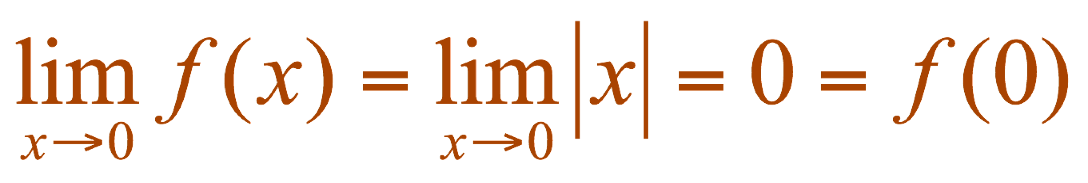
Note
The converse of Theorem 4 is false. That is, there are functions that are continuous but not differentiable. For instance, the function f(x) = |x| is continuous at 0 because
See Example 6 in Section 1.4.
However, in Example 5, we showed that f is not differentiable at 0.

Slide 38
How can a Function Fail to be Differentiable?

Slide 39
How can a Function Fail to be Differentiable?
In general, if the graph of a function f has a “corner” or “kink” in it, then the graph of f has no tangent at this point and f is not differentiable there.
Theorem 4 gives another way for a function not to have a derivative. It says that if f is not continuous at a, then f is not differentiable at a.
So at any discontinuity (for instance, a jump discontinuity) f fails to be differentiable.

Slide 40
How can a Function Fail to be Differentiable?
A third possibility is that the curve has a vertical tangent line when x = a; that is, f is continuous at a and
This means that the tangent lines become steeper and steeper as x → a.

Slide 41
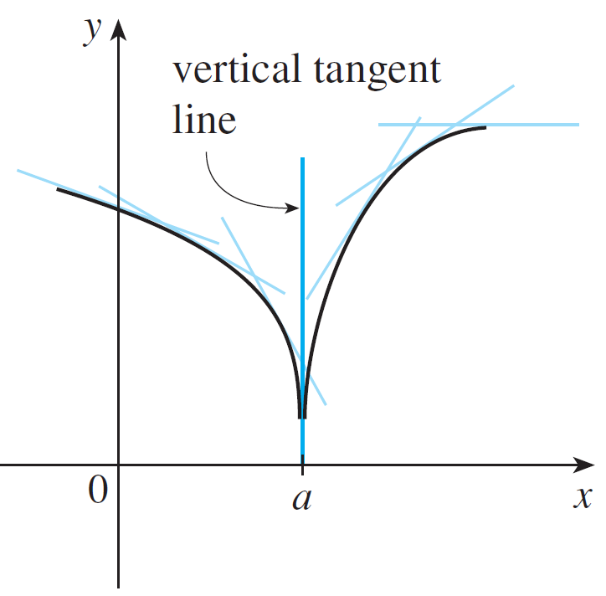
How can a Function Fail to be Differentiable?
Figure 6 shows one way that this can happen; Figure 7(c) shows another.
A vertical tangent
Figure 6
Figure 7(c)

Slide 42
How can a Function Fail to be Differentiable?
(a) A corner
(b) A discontinuity
(c) A vertical tangent
Three ways for f not to be differentiable at a
Figure 7
Figure 7 illustrates the three possibilities that we have discussed.

Slide 43
HOW CAN A FUNCTION FAIL TO BE DIFFERENTIABLE?
A graphing calculator or computer provides another way of looking at differentiability.
If f is differentiable at a, then when we zoom in toward the point (a, f(a)), the graph straightens out and appears more and more like a line.
See Figure 8.
We saw a specific example of this in Figure 4 in Section 2.1.

Slide 44
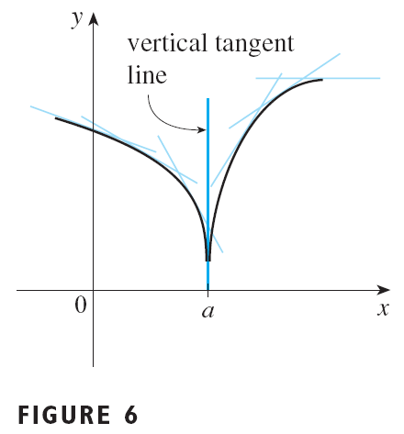
HOW CAN A FUNCTION FAIL TO BE DIFFERENTIABLE?
But no matter how much we zoom in toward a point like the ones in Figure 6 and 7(a), we can’t eliminate the sharp point or corner, as in Figure 9.

Slide 45
Higher Derivatives

Slide 46
Higher Derivatives
If f is a differentiable function, then its derivative f ′ is also a function, so f ′ may have a derivative of its own, denoted by (f ′)′ = f ″.
This new function f ″ is called the second derivative of f because it is the derivative of the derivative of f.
Using Leibniz notation, we write the second derivative of as y = f (x) as

Slide 47
Example 6
If f (x) = x³ – x, find and interpret f ″(x).
SOLUTION:
We must remember that the variable is h and that x is temporarily regarded as a constant during the calculation of the limit.

Slide 48
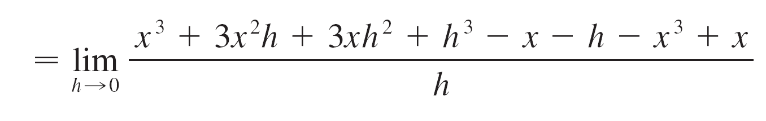
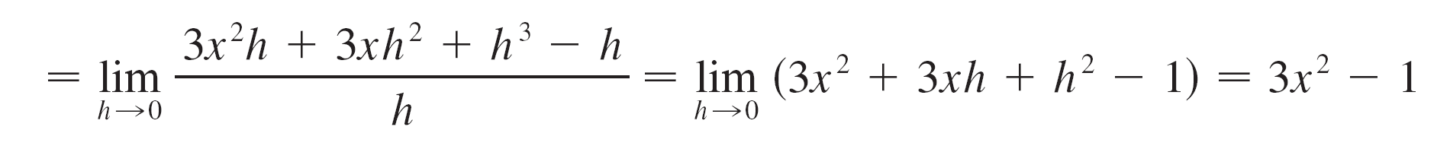
Example 6 – Solution
cont’d

Slide 49
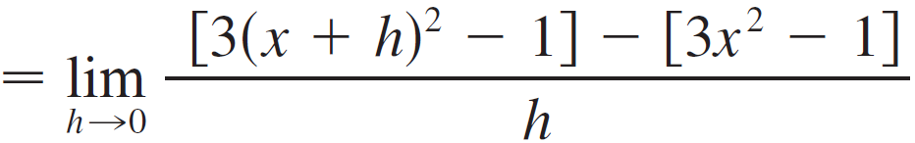
Example 6 – Solution
cont’d
We found that the first derivative is
Similarly the second derivative is

Slide 50
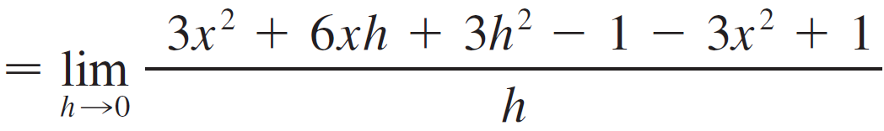

Example 6 – Solution
cont’d

Slide 51
Example 6 – Solution
cont’d
Figure 10
The graphs of f, f ′, f ″ are shown in Figure 10.

Slide 52
Example 6 – Solution
cont’d
We can interpret f ″(x) as the slope of the curve y = f ′(x) at the point (x, f ′(x)).
In other words, it is the rate of change of the slope of the original curve y = f (x).
Notice from Figure 10 that f ″(x) is negative when y = f ′(x) has negative slope and positive when y = f ′(x) has positive slope.
So the graphs serve as a check on our calculations.

Slide 53
Higher Derivatives
In general, we can interpret a second derivative as a rate of change of a rate of change. The most familiar example of this is acceleration.
The instantaneous rate of change of velocity with respect to time is called the acceleration of the object.

Slide 54
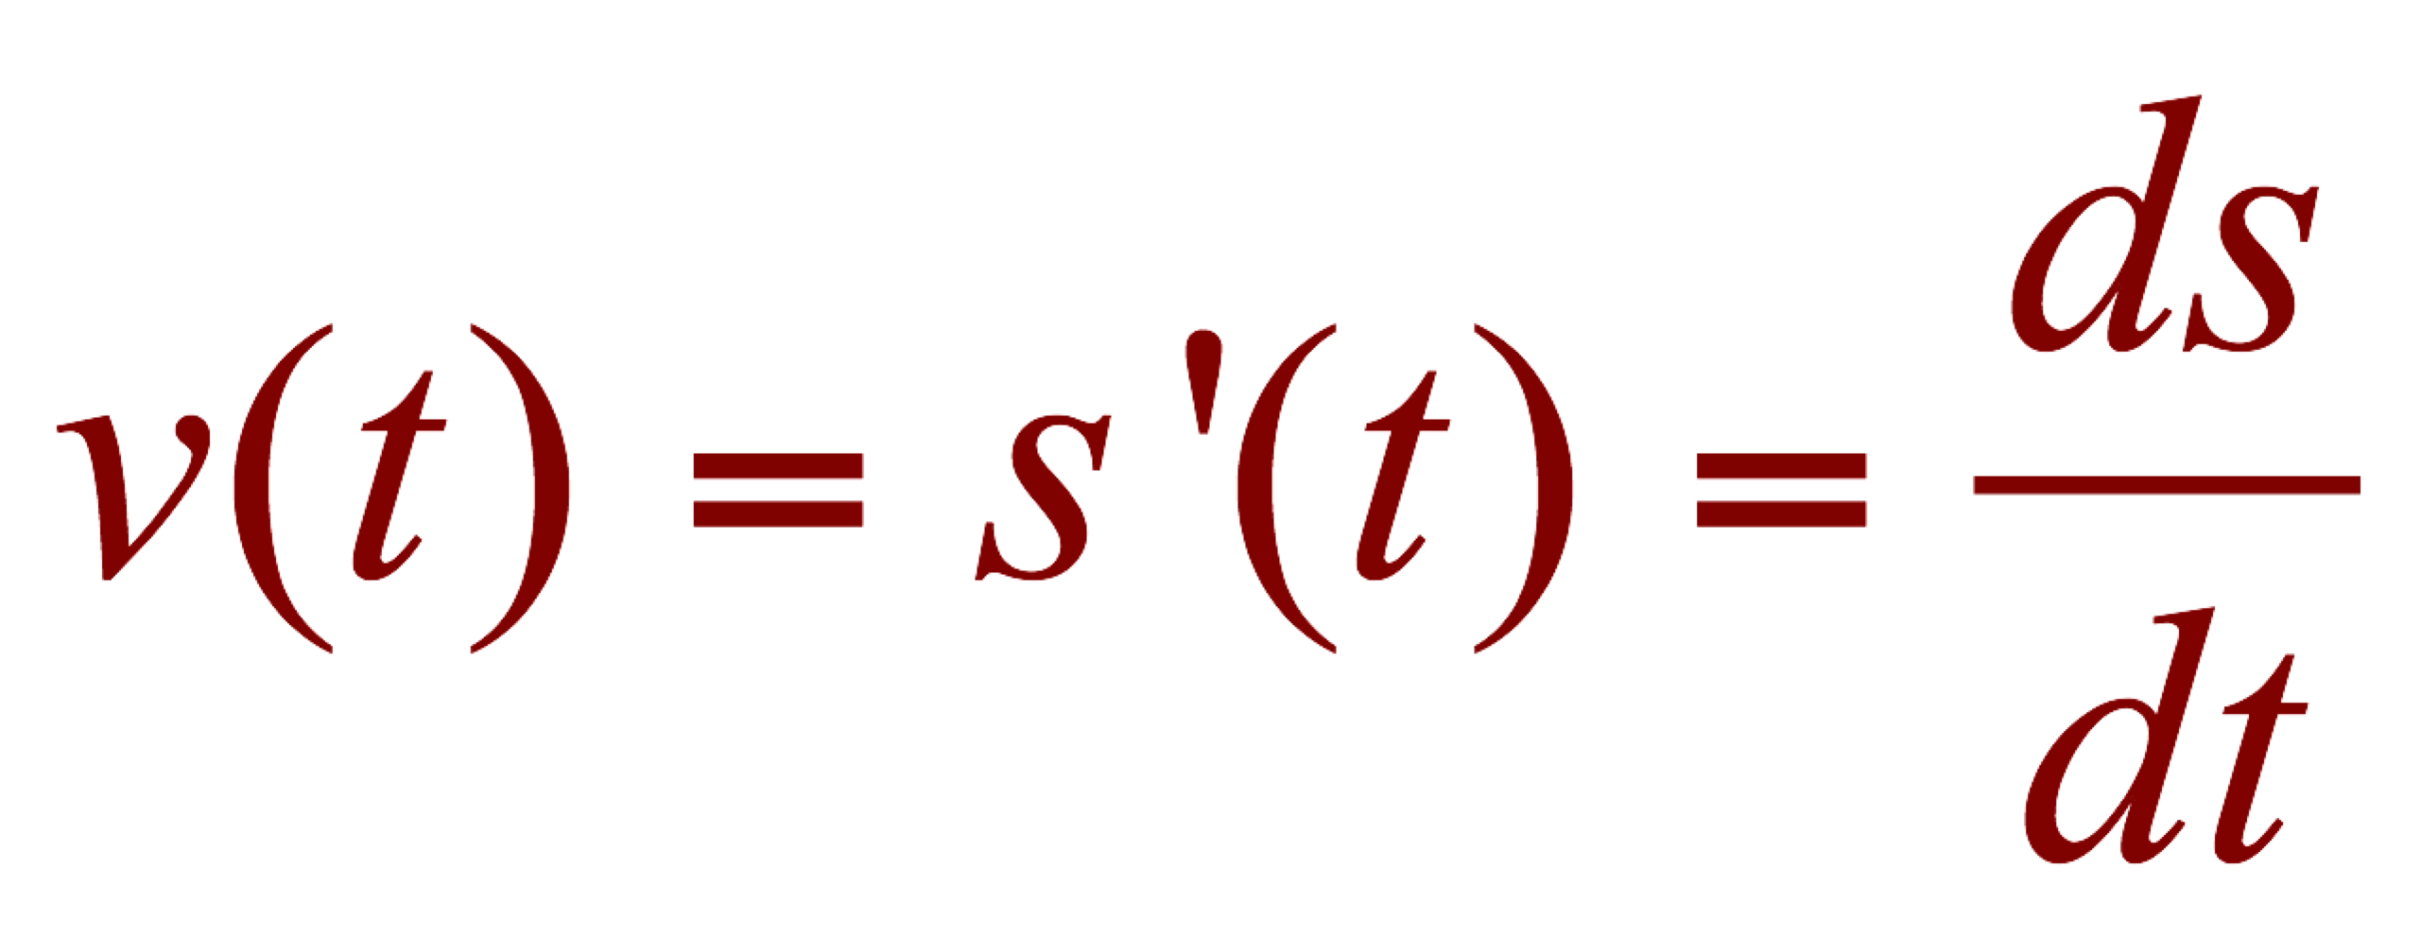
Higher Derivatives
If s = s(t) is the position function of an object that moves in a straight line, we know that its first derivative represents the velocity v(t) of the object as a function of time:

Slide 55
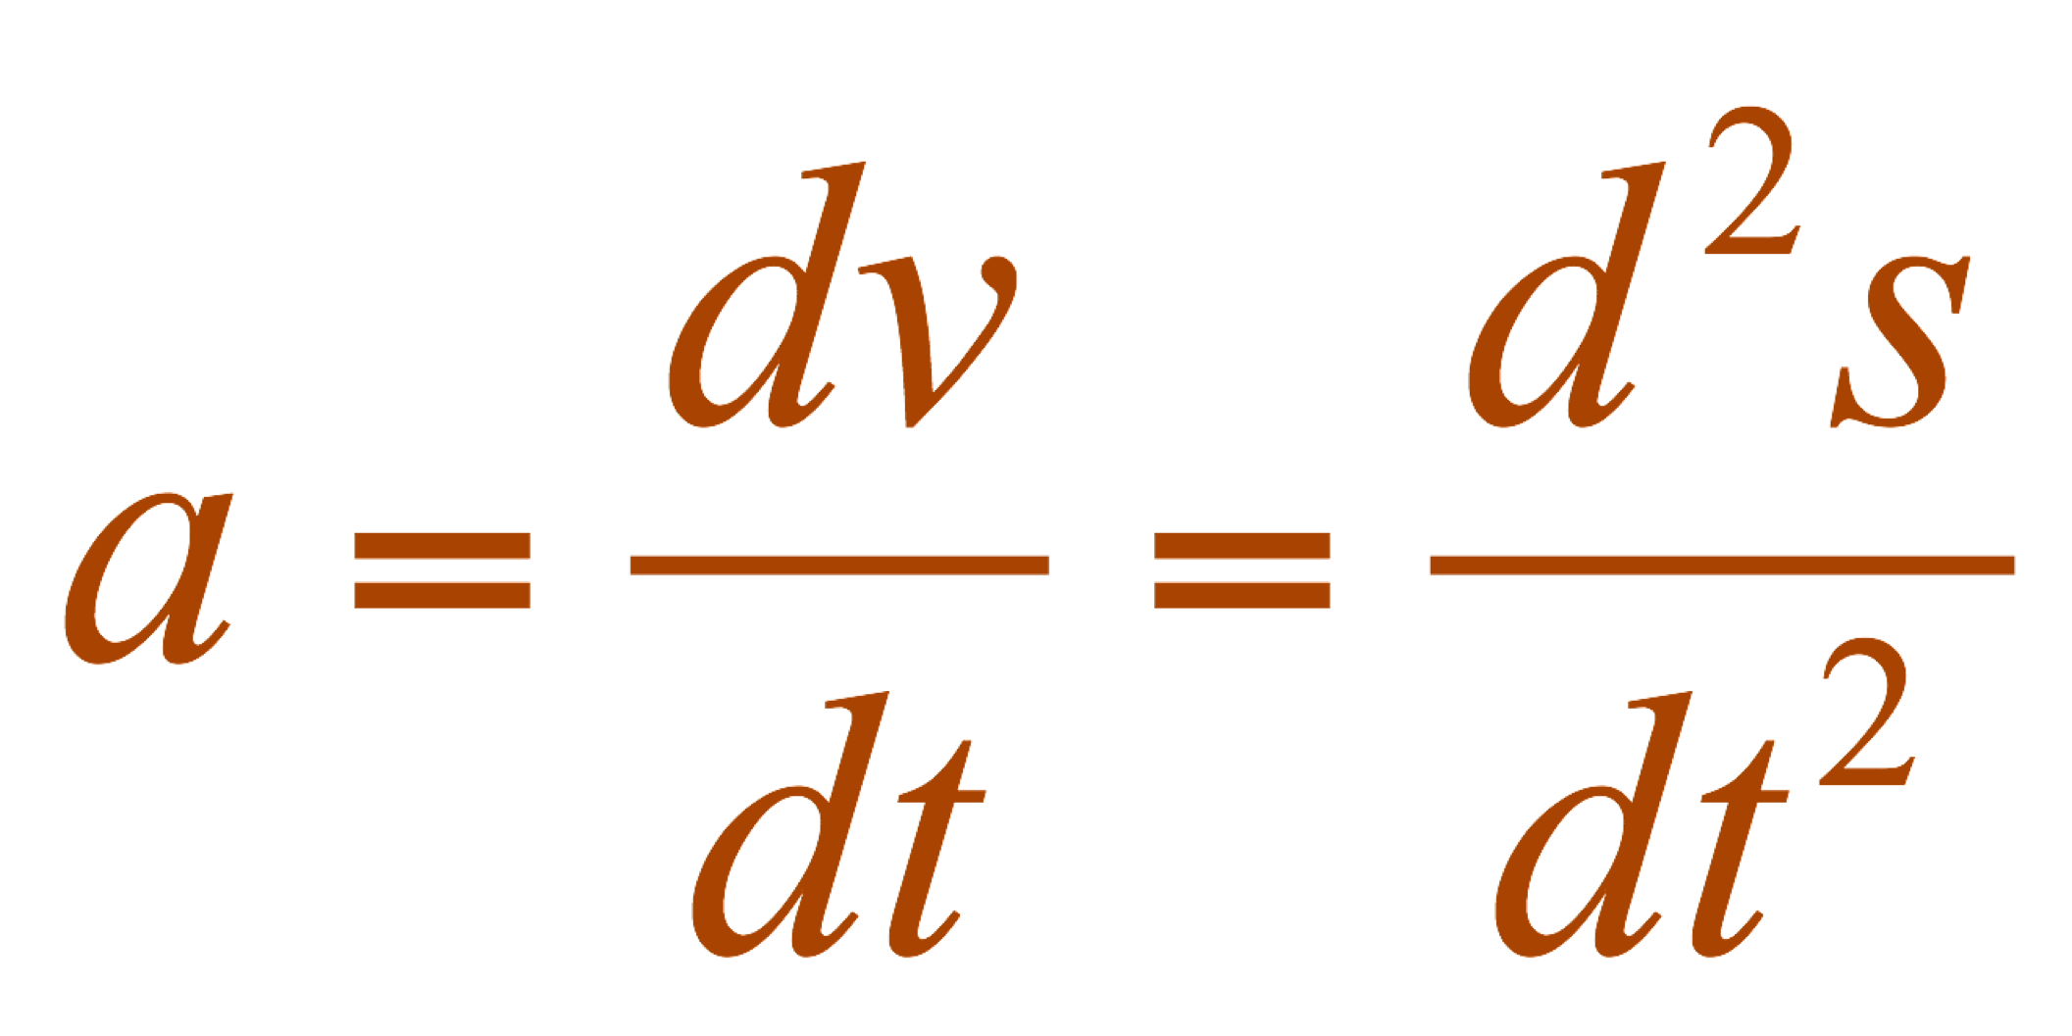
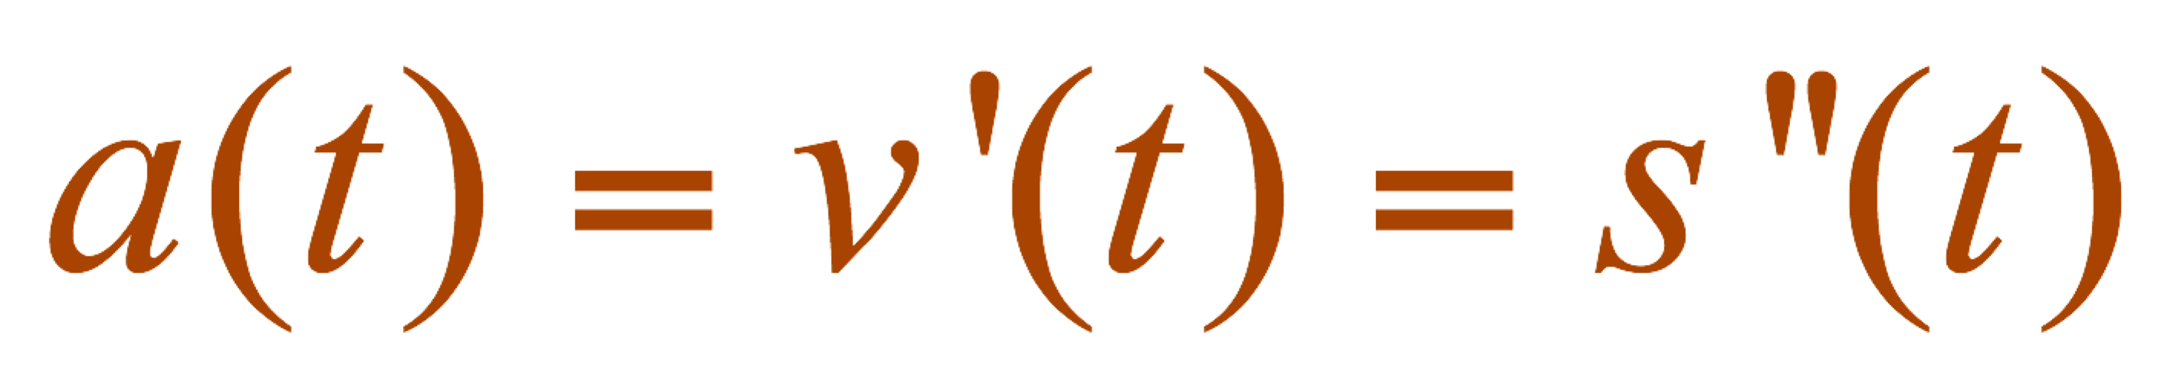
HIGHER DERIVATIVES
The instantaneous rate of change of velocity with respect to time is called the acceleration a(t) of the object.
Thus, the acceleration function is the derivative of the velocity function and is, therefore, the second derivative of the position function:
In Leibniz notation, it is:

Slide 56
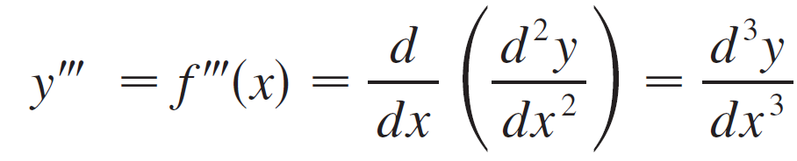
Higher Derivatives
The third derivative f ″′ is the derivative of the second derivative f ″′ = (f ″)′.So f ″′(x) can be interpreted as the slope of the curve y = f ″(x) or as the rate of change of
f ″(x).
If y = f (x), then alternative notations for the third derivative are
The process can be continued. The fourth derivative f ″″ is usually denoted by f ⁽⁴⁾.

Slide 57
Higher Derivatives
In general, the nth derivative of f is denoted f ^{(n)} by and is obtained from f by differentiating n times.
If y = f (x), we write

Slide 58
Example 7
If , find f ’’’(x) and f ⁽⁴⁾(x).
SOLUTION:
In Example 6, we found that f ’’(x) = 6x.
The graph of the second derivative has equation y = 6x.
So, it is a straight line with slope 6.

Slide 59
Example 7 SOLUTION
Since the derivative f ’’’(x) is the slope of f ’’(x), we have f ’’’(x) = 6 for all values of x.
So, f ’’’ is a constant function and its graph is a horizontal line.
Therefore, for all values of x, f ⁽⁴⁾ (x) = 0

Slide 60
HIGHER DERIVATIVES
We have seen that one application of second derivatives occurs in analyzing the motion of objects using acceleration.
We will investigate another application of second derivatives in Section 4.3, where we show how knowledge of f '' gives us information about the shape of the graph of f.
In Section 8.7 we will see how second and higher derivatives enable us to represent functions as sums of infinite series.

